Slide 1
Information Encoding and Entropy

Slide 2
The Basics
The fundamental concepts discussed here were first presented by Claude Shannon in his 1948 paper “A Mathematical Theory of Communication” in the Bell Systems Technical Journal (100,000+ citations)
The paper was aimed at creating a baseline mathematical framework for describing communication systems
There are three major components of communication process flow: Source → Channel → Destination
The aim of communication systems was to make all these processes maximally efficient – transfer maximum information compressed into least data at the maximum rate
From this viewpoint, the Source could be split into two parts – data compression and data transmission
Information encoding concepts appear in the first part.

Slide 3
An illustrative example
These concepts deal with the relationships between probabilities of occurrence of events, number of bits needed to communicate the occurrence of events, and the information content in these events
We will use a simple and appropriate example to illustrate these concepts:
In a horse race, there are 8 horses and they have different probabilities of winning. They have run the race and the outcome in terms of the winning horse’s identity has to be communicated across using binary digits. What is the average number of bits needed?
Is it 3?
No, the answer is 2!
We will see the innovation behind this …
.... and that innovation is the basis of Information Encoding and Entropy.

Slide 4
An illustrative example
Horse ID’s : 1 2 3 4 5 6 7 8
Winning probs. (p): 1/2 1/4 1/8 1/16 1/64 1/64 1/64 1/64
Allotted Bits: 1 2 3 4 6* 6 6 6
In terms of p: log₂(2) log₂(4) … in all cases:
Conceptually, the less the prob. of something occurring, the more the ripples / news made by its occurrence. Hence, the more is its information content. Examples:
in a typical summer, a sunny day versus a day of sudden rain
in a 24/7 process, normal operation versus a crash / accident / breakdown.
So less the prob., the more the information content, and the more should be the facility (bits) to transfer that information content
This concept is faithfully reproduced in the scheme represented in the above example!
The Average number of bits needed is:

Slide 5
Information Entropy
Entropy in a system ~ Degree of instability or disorder in the system
Disorder in an information system: Degree of uncertainty / unpredictability of the system ⇒ more the amount of information needed to describe that system
~ net sum of (prob. of individual event x information content of the event) _{for a given distribution X}
~ Entropy
Hence, Information Entropy:
Let us apply this concept to the Classification problem:
That selection of attributes / features for classification is best which takes us to the lowest possible level of information entropy, i.e. H(X_{new}) is as low as possible
i.e. H(X_{old}) – H(X_{new}) is the maximum (note: H(X_{old}) is known)
this is the principle followed in the decision tree formalism.
Let us look at another example for verification of the concept of information entropy.

Slide 6
Information Entropy
Let there be 2 events: 1 & 2, with probs. p₁ and p₂ (= 1–p1)
Let us take different cases: (i.e. different distributions of probability)
Information Entropy:
Case A:
Case B: same as A, by symmetry
Case C:
Case D: ≡ Case E
Distribution of entropy against p₁ is shown in next slide.
Probs. | Case A | Case B | Case C | Case D | Case E
p₁ | 0 | 1 | 1/2 | 1/4 | 3/4
p₂ | 1 | 0 | 1/2 | 3/4 | 1/4

Slide 7
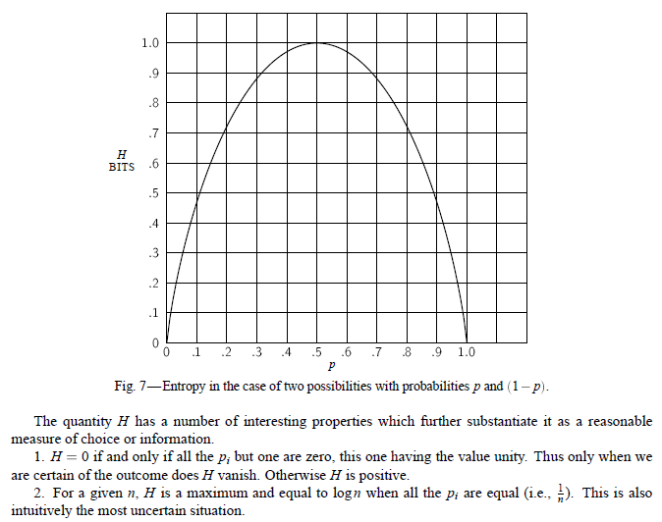
Important to note that entropy is minimum under conditions of absolute certainty, and maximum under maximal uncertainty / unpredictability as manifested in a constant distribution of prob.

Slide 8
THANK YOU

